Slide 1
SafeRide: A Real-Time IoT-Based Smart Helmet
with Road-Condition Intelligence
Present by
Abdul Jobayer
Faculty of Computer Science and Engineering
Patuakhali Science and Technology University
Patuakhali-8602, Bangladesh
ug2102008@cse.pstu.ac.bd
Authors
Mohammed Sakib Hasan
Jihadul Islam
Md. Abdul Jobayer
Md. Abdur Rakib
Md. Mohidul Alam
Md. Mahbubur Rahman

Slide 2
Abstract
Motorcycle riders are among the most vulnerable road users, often facing a high risk of accidents and fatalities.
These risks arise from unsafe riding habits, poor road conditions, and delays in emergency response. Many existing smart helmet systems focus on single features such as alcohol detection or accident alerts, but lack a complete and scalable solution. To address these issues, this paper proposes a low-cost, realtime IoT-enabled smart helmet system that combines multiple safety and awareness features into one framework. The system integrates helmet-wear detection, alcohol monitoring, drowsiness detection, rear-vehicle proximity alerts, accident and emergency
notifications, and weather-based warnings. A new road-condition prediction model using machine learning is introduced, which classifies upcoming roads as excellent, good, poor, or very poor based on GPS data. The helmet and motorcycle units are synchronized to control ignition and share data in real-time, while hazard information is uploaded to Firebase for community alerts. A smartphone application provides riders with live sensor data, navigation, and voice-based notifications to reduce distractions. Additionally, the SafeRide dataset of road conditions has been developed to support large-scale road-quality prediction across Bangladesh. Experimental results show that the proposed system is effective in improving rider safety and enabling intelligent transportation solutions.

Slide 3
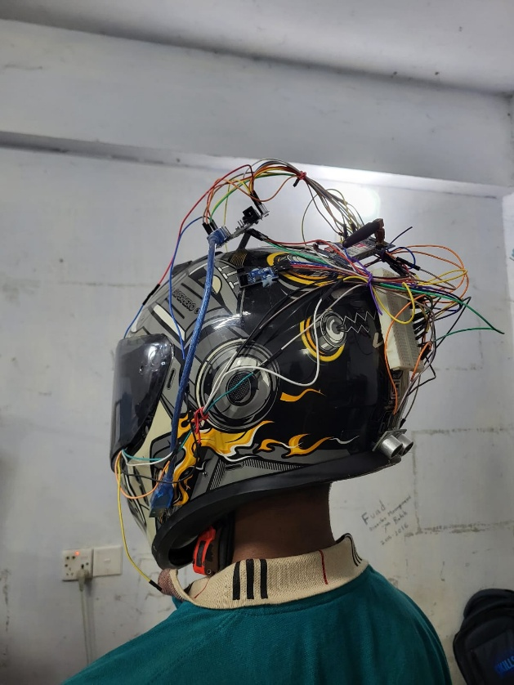
Introduction
SafeRide is a real-time IoT-based smart helmet designed to enhance motorcycle safety. It integrates sensors for helmet use, alcohol and drowsiness detection, accident alerts, and road-condition prediction using machine learning. The system connects with a smartphone app and cloud to deliver live monitoring and emergency notifications, helping riders stay alert and protected. By combining multiple safety features in one platform, SafeRide promotes smarter and safer transportation.

Slide 4
Problem Statement
Current Smart Helmet Systems:
Motorcycle riders are highly vulnerable to accidents due to unsafe riding, fatigue, alcohol use, and poor road conditions.
Many existing smart helmets focus on only one feature, such as alcohol detection or accident alerts.
There is no complete, real-time system that integrates all key safety functions.
Delayed emergency response often increases the severity of injuries and fatalities.
A low-cost IoT-based smart helmet is needed to combine multi-sensor safety, monitoring, and intelligent alerts to enhance rider protection.

Slide 5
Objective of SafeRide
Develop a low-cost, real-time IoT-based smart helmet for motorcycle riders.
Integrate multiple safety features: helmet use, alcohol detection, drowsiness, accident, and weather monitoring.
Enable automatic emergency alerts through GSM and GPS modules.
Implement machine learning to predict road conditions (Excellent–Very Poor).
Provide real-time data visualization and alerts via a smartphone app.
Enhance overall rider safety and community awareness through cloud-based data sharing.

Slide 6
Related work (Literature Review)
Early systems focused on single features such as accident detection, alcohol sensing, or GPS tracking.
Islam et al. (2020) designed a gyroscope-based accident detection system with local alerts [2].
Hu et al. (2018) developed a low-cost alcohol detection module using the MQ-3 sensor [4].
Anish et al. (2023) combined IR helmet detection, alcohol, and accident sensors with GSM/GPS for emergency response [5].
Limitations of Prior Work:
Most lacked real-time cloud connectivity and multi-sensor integration [6][7].
High false alarm rates and limited scalability in emergency communication [9].
Focused primarily on car-oriented systems rather than motorcycle applications [3].

Slide 7
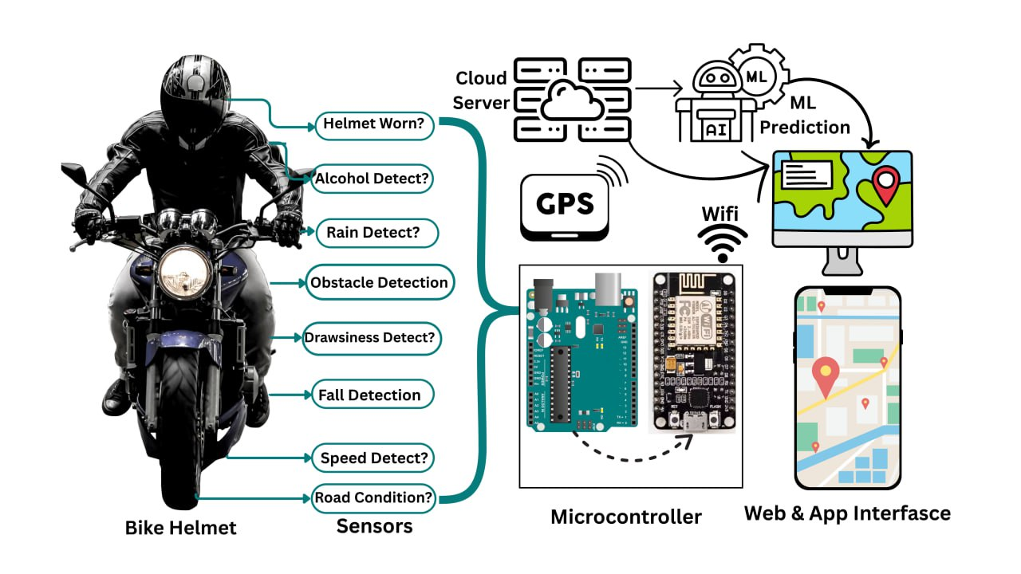
System Architecture
Layers:
Sensor → Microcontroller (ESP32 + Arduino UNO) → Wi-Fi (NodeMCU) → Cloud Database (MySQL) → ML Inference (Road Condition Prediction) → Visualization & Alerts (Mobile/Web App)
Data Path:
Serial (UART 9600) → Wi-Fi → REST/API → Smartphone
Dashboard
Dual Mode:
Local (LCD + Buzzer Alerts) + Remote (Cloud Dashboard & Emergency SMS)
Feedback Loop:
Predicted risks and unsafe conditions trigger contextual alerts and safety recommendations for riders.
IEEE International Conference on Robotics, Automation, Artificial-Intelligence and Internet-of-Things 2025

Slide 8
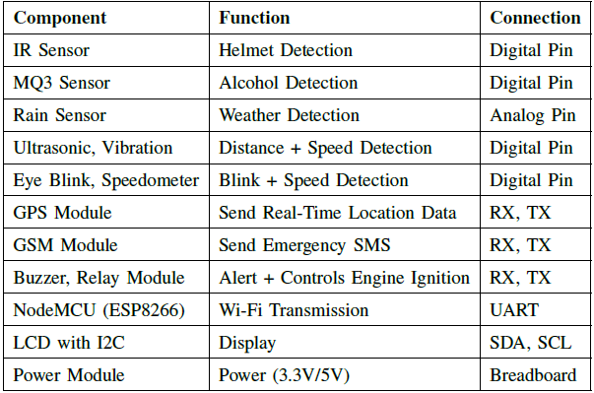
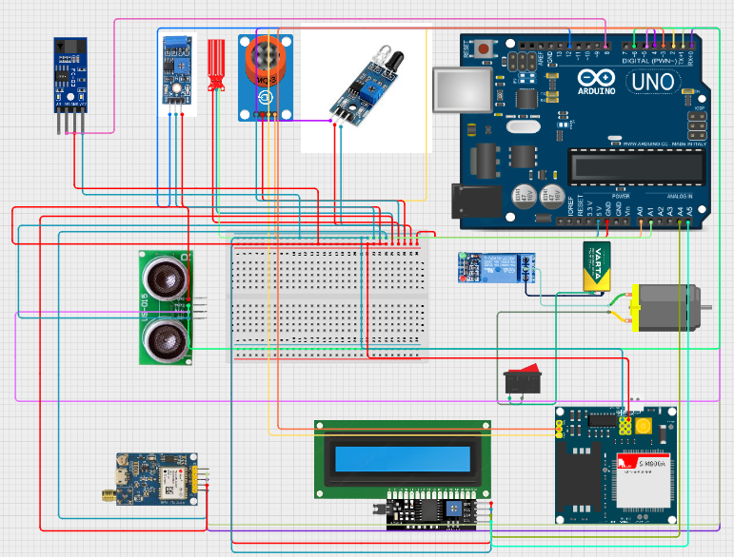
Hardware Component & Integration

Slide 9
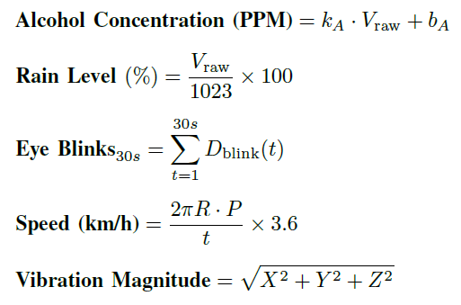
Data Acquisition & Processing
Sensors measure parameters such as alcohol level, rain intensity, speed, and vibration.
Data is processed by the ESP32 microcontroller and transmitted to the cloud via Wi-Fi for real-time monitoring.

Slide 10
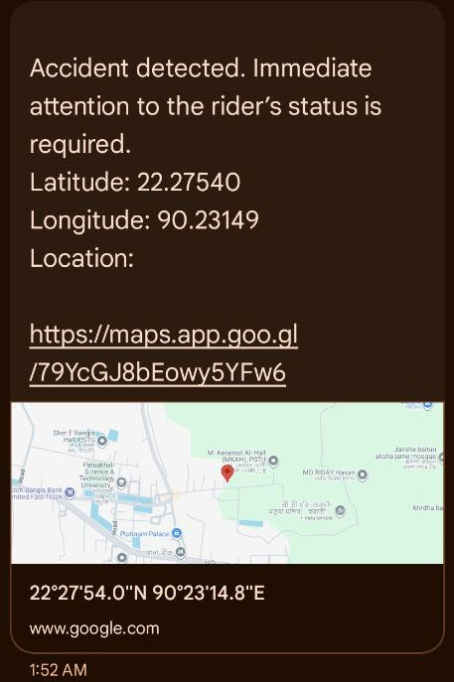
Alert System
Helmet not worn → Ignition automatically turns off
Alcohol > 200 ppm → Engine stops and buzzer alert activates
Drowsiness (Eye-blinks > 10 per 30s) → Buzzer warning sounds
Accident detected → Emergency SMS sent with GPS location
Weather alerts → Rain or low visibility warnings
Rear-vehicle proximity → Ultrasonic sensor triggers distance alarm

Slide 11
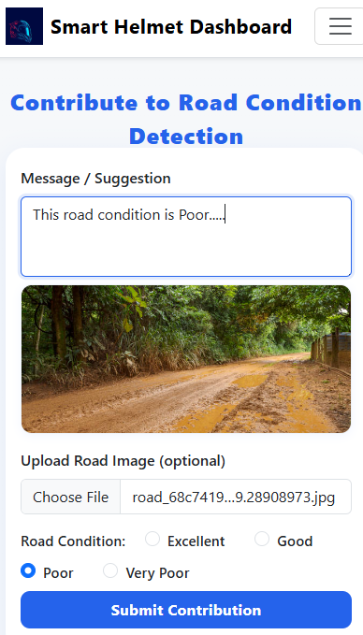
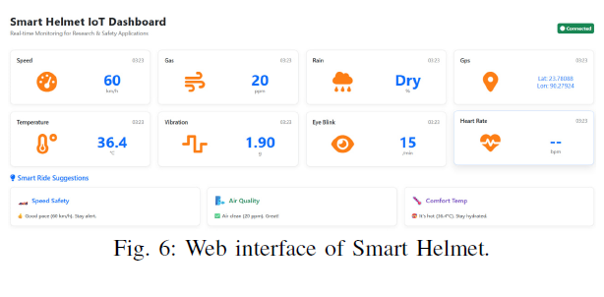
Smartphone App Workflow
Capture & Label: Riders capture road images and label conditions (Excellent / Good / Poor / Very Poor).
Geo-tagging: GPS coordinates and timestamps are automatically attached.
Upload & Storage: Data is uploaded to the cloud (MySQL) for validation and analysis.

Slide 12
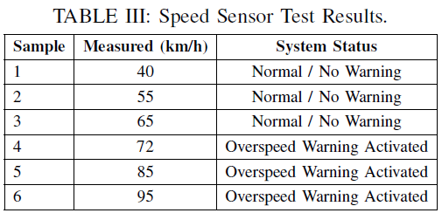
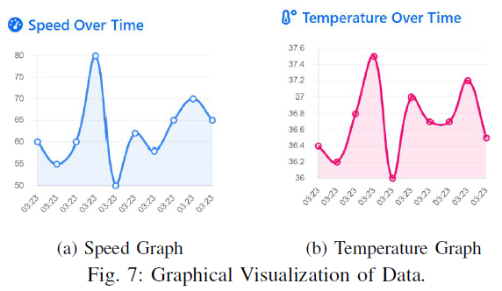
Experimental Results
MQ3 Alcohol Sensor Test (Table II):
Engine remains ON below 200 ppm.
Above 200 ppm → Engine stops + alarm activates.
Speed Sensor Test (Table III):
Normal operation below 70 km/h.
Overspeed warning triggered beyond 70 km/h.
System Validation:
Consistent accuracy in detecting alcohol level and speed threshold.
Real-time response verified through prototype testing.
Graphical Results (Figs. 7):
Speed vs Time and Temperature vs Time show live data monitoring through web and mobile dashboards.

Slide 13
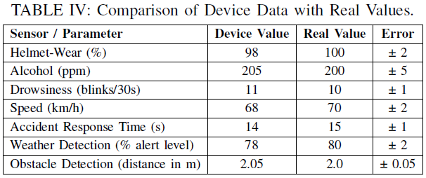
System Validation
Accuracy Comparison (Table IV):
Device readings closely match real-world values.
Achieved 98–99% accuracy across helmet wear, alcohol, drowsiness, speed, and weather detection.
Performance Metrics (Table V):
SafeRide significantly outperforms existing systems.
Faster response time (Emergency SMS latency reduced to ~5.5s).
Key Highlights:
Helmet detection F1-Score: 0.96 ± 0.02
Alcohol detection AUC-ROC: 0.98
Fall detection recall: 97 ± 1.5%
Ignition interlock success: 99.5%

Slide 14
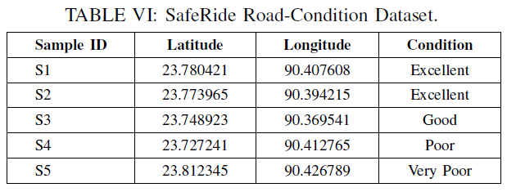
Road-Condition Dataset
Dataset Name: SafeRide Dataset (available on Kaggle)
Source: Crowdsourced road-condition data from riders across Bangladesh.
Entries Collected: 166 records in pilot deployment.
Categories: Excellent, Good ,Poor , Very Poor
Features: Each record includes GPS coordinates, timestamp, and image label.
Purpose: Supports ML model training for real-time road-condition prediction and community hazard awareness.

Slide 15
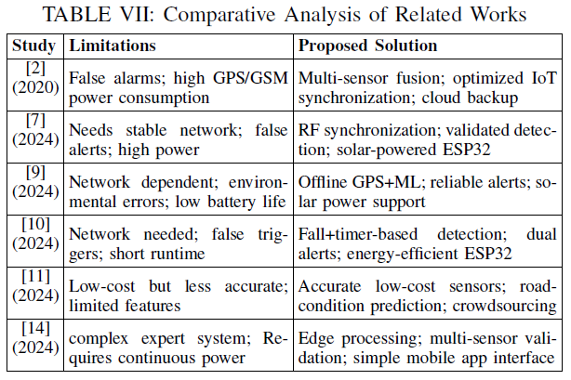
Comparative Analysis With Existing System
.

Slide 16
Conclusion & Future Work
Conclusion:
Developed a multi-sensor IoT-based smart helmet for real-time rider safety.
Integrates alcohol, drowsiness, accident, weather, and road-condition intelligence into one system.
Demonstrated high accuracy (~98–99%) and fast emergency response.
Future Work:
Nationwide crowdsourced road-condition mapping.
Integration of deep learning and edge AI for faster on-device inference.
Addition of biometric sensors and adaptive voice control.
Expansion toward a smart transportation safety ecosystem.

Slide 17
References
M. M. Islam et al., “Design and Implementation of a Smart Bike Accident Detection System,” IEEE TENSYMP, Dhaka, Bangladesh, 2020.
W. Hu et al., “Design of Vehicle-Based Alcohol Detection System Using IoT,” IOP Conf. Ser.: Mater. Sci. Eng., 2018.
K. Anish et al., “Smart Helmet with Accident Detection Using IoT,” ICPCSN, 2023.
J. S. Vani et al., “HelmetGuard: IoT-Based Smart Helmet for Rider Safety,” STCR, 2023.
P. Asha et al., “Ensuring Safety Drive through a Smart Helmet Design Using IoT,” ICCPCT, 2024.
S. A. Islam et al., “Smart Helmet with IoT Integration: Enhancing Rider Safety with Real-Time Hazard Alerts,” ICCIT, 2024.
M. Jahidul Islam et al., “An IoT-Based Smart Helmet for Riding Security and Emergency Notification,” ICEEICT, 2024.
S. S. Tashfia et al., “Intelligent Motorcycle Monitoring Scheme Using IoT with Expert System in Bangladesh,” ICCIT, 2020.
Mohammed Sakib Hasan, “SafeRide Dataset,” Kaggle, 2025.

